Slide 1
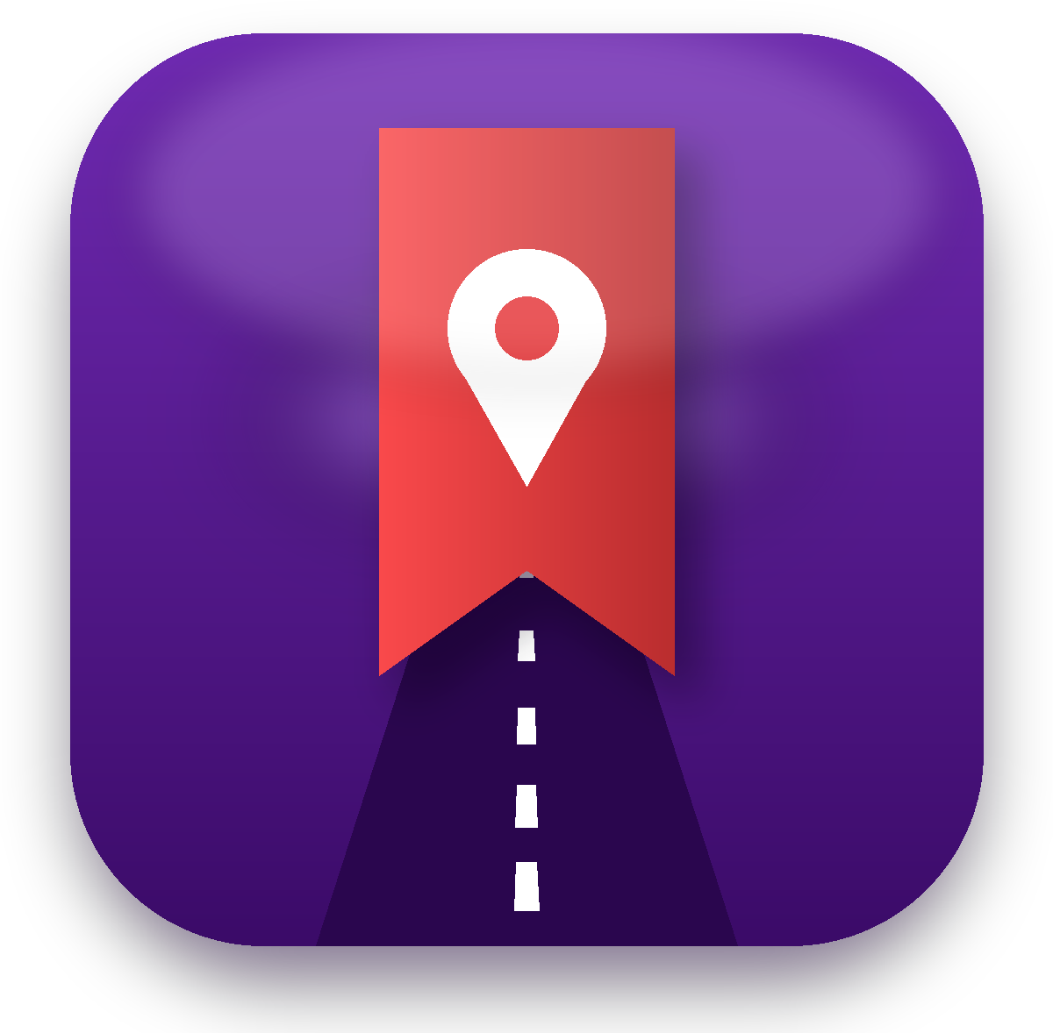
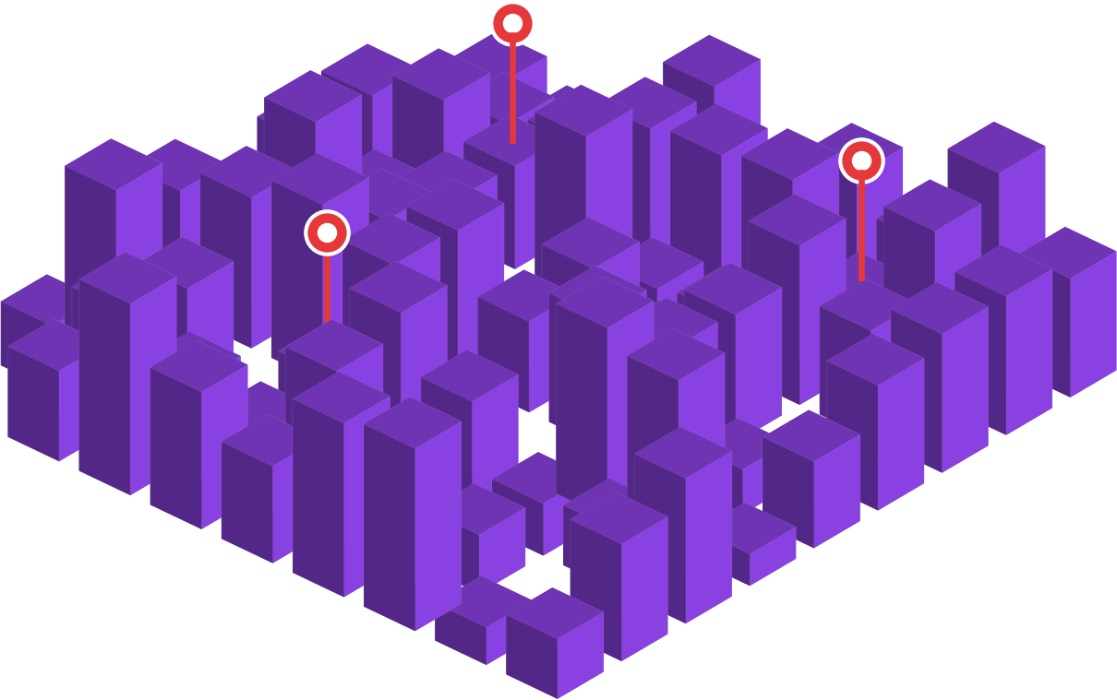
Your recommendations deserve a second life.
Spotted credits you for every save. Go Pro and all your reels become one page followers save from.
Start →

Slide 2

STEP 1 OF 4
You make a reel about a yummy place.
Your followers love it.

Slide 3

STEP 2 OF 4
They save it… and forget.
A week later, your recommendation is lost.

Slide 4

STEP 3 OF 4
Spotted credits you and reminds them nearby.
"You're near the café @you recommended!"

Slide 5

STEP 4 OF 4
They visit. Pro creators get stars and earn.
Proof that you bring real customers.
See what's in it for you →

Slide 6




What's inside
Tap any card. The Menu button on every slide brings you back.
Your page
All your picks in one place →
Stars & earnings
Pro: yellow and green stars →
Free vs Pro
Free credit, Pro AED 249 →
What we need
A bio link and one line →
Payments
For Creator Pro only →
Questions
24 answers →

Slide 7

Pro: every reel, automatically
Menu
1
Your reels appear by themselves
Connect Instagram or TikTok. Every reel and its place shows up on your page.
N
@brunchwithnoor
★ 1,240 stars · Dubai
Save all 12 places
One place or "Save all"
Followers pick the place they want, or save your whole list.
2
Café in JLT
Order: pistachio croissant
3
Reminders bring them in
"You're near the café @brunchwithnoor recommended."
Bakery in Al Quoz
Order: cardamom bun
4
Followers follow you on Spotted
Your new picks reach them first.
Brunch spot, Marina
Go early on Fridays
Example creator is fictional.

Slide 8


Pro: stars prove your influence
Menu
Yellow star
Green star
Someone saves a place from your reel
They actually visit and scan at the counter
Counted from day one
Go Pro and see your full history
Restaurants see who brings guests
Better brand deals
Top Creator of the Month
Featured on the home screen

Slide 9
Example: one reel, real results
Menu
1
1,200
180
64
~AED 130
reel posted
yellow stars (saves)
reminded nearby
green stars (visits)
earned from coupons
On top of your usual fee per reel, plus proof of 64 real visits to show your next brand.
Illustrative numbers. Creator earnings share will be confirmed before launch.

Slide 10



Every kind of creator fits
Menu
Food
@brunchwithnoor
Shopping
@modestfinds_dxb
Activities
@weekendsinuae
Café in JLT
Try: pistachio croissant
Boutique in Al Wasl
Loved: linen abaya
Kayaking at Kite Beach
Tip: go at sunset
Followers save it, get reminded nearby, and you collect stars.
Followers save it, get reminded nearby, and you collect stars.
Followers save it, get reminded nearby, and you collect stars.
Example creators are fictional.

Slide 11
Free gives credit. Pro gives you a page
Menu
Free
Pro
"Saved from @you's reel" credit on every save
✓
✓
All your reels appear in the app automatically
–
✓
Followers save one place or "Save all"
–
✓
Yellow and green stars + stats
–
✓
Detailed analytics and earnings tools
–
✓
Featured on the home screen
–
✓
Pro: AED 249/month, 2 months free. Stars are counted from day one and appear when you go Pro.

Slide 12





Your followers will love it
Menu
Birthday treat
Dietary & family filters
Group voting
A free dessert or drink in their birthday month
Vegan, gluten-free, kid-friendly, family seating
Friends vote on where to go tonight
Ramadan mode
Invite 3 friends
Family activities
Iftar and suhoor guide
Get a Passport stamp or bonus coupon
Parks, play areas, weekend plans
Free for users. Max 1 notification per area every 4–6 hours, and 3 a day.

Slide 13
For Pro: two small things
Menu
1. Spotted link in your bio
2. One line at the end
@brunchwithnoor
Brunch & coffee in Dubai
Link: spotted.ae/@brunchwithnoor
"Save all my recommendations on Spotted"
Followers open all your picks in one tap.
Say it or show it as text at the end of each video.
Connect Instagram or TikTok and your reels appear by themselves. You're live.

Slide 14


Simple payments, no surprises
Menu
2 months free
Then prepaid
Payment issue?
After 60 days
Try everything first
Monthly, or yearly: pay 11 months, get 12
Fully active for 60 more days
Profile hidden. Content kept safe
After 60 days: your Pro profile is hidden from followers and you can't see your content or receive stars, but everything is kept safe. Followers keep the places they saved through you. Pay anytime and it all comes back. (Free creators have no payments.)

Slide 15


"Why pay AED 249?"
Menu
Because it pays you back. Free still credits every save.
Charge brands more
Earn on top of your fee
Your reels keep working
"My reel brought 64 real visits" beats views.
A share when followers use your coupons.
Months of visits, not 2 days of views.

Slide 16
Your questions, answered
Menu
Tap a topic to see the answers.
4
4
4
Free & Pro
What do free creators get? →
Payments
How do I pay for Pro? →
Stars & earnings
How do stars work? →
4
4
4
Your content
Who owns my content? →
Your followers
What do followers get? →
Working with Spotted
Is it exclusive? →

Slide 17
Free & Pro
Menu
What do free creators get?
What is Creator Pro?
Credit: when someone saves a place from your reel, the app shows "Saved from @you's reel". No page, stars or stats.
AED 249/month. All your reels appear automatically, followers save one place or all, plus stars, analytics and earnings.
Is there a free trial?
What if I cancel Pro?
Yes. Pro is free for your first 2 months.
You go back to free: credit only. Your page is hidden, nothing is deleted, followers keep their saves.
← All questions
Next topic →

Slide 18
Payments
Menu
How do I pay for Pro?
What if my payment fails?
AED 249/month prepaid, or AED 2,739 a year (pay 11 months, get 12).
Your Pro account stays fully active for 60 days.
What happens after 60 days?
Can I come back?
Your profile is hidden. Your content stays safe, but you can't see it or receive stars.
Yes. Pay, and everything switches back on.
← All questions
Next topic →

Slide 19
Stars & earnings
Menu
How do stars work?
What do stars do?
Pro only: yellow for a save, green for a visit. We count from day one, so going Pro shows your full history.
More stars mean more reach, and restaurants see you bring real customers.
How do I earn?
What is Top Creator of the Month?
A share when followers use coupons from your picks, plus brand deals.
The creator with the most stars gets featured on the home screen.
← All questions
Next topic →

Slide 20
Your content
Menu
Who owns my content?
What do I need to do?
You do. Spotted links to or embeds your reels, never reposts them.
Pro: connect Instagram or TikTok, add our bio link and end videos with "Save all my recommendations on Spotted". Free: nothing.
Which platforms work?
Are paid picks labelled?
Instagram and TikTok at launch. YouTube and others later.
Yes, always marked "Sponsored", following UAE advertising rules.
← All questions
Next topic →

Slide 21
Your followers
Menu
What do followers get?
Will they get spammed?
From Pro creators: "Save all" in one tap, reminders nearby, coupons, birthday treats and more.
No. Max 1 notification per area every 4-6 hours and 3 a day.
Do followers pay?
Is their data safe?
No. Spotted is free for users.
Yes. Locations stay on their phones. You see totals only.
← All questions
Next topic →

Slide 22
Working with Spotted
Menu
Is it exclusive?
Can restaurants contact me?
No. Work with any brand or app.
Yes, for brand deals, only if you choose.
Where does it start?
How do I join?
Khalifa City, Abu Dhabi, then more areas.
Tap "Business owner or influencer?" in the app, or WhatsApp us on +971 50 873 3160.
← All questions

Slide 23


Be a founding creator
Menu
Featured on the home screen at launch
Early access to creator earnings
Founding creator badge
We build your page with you
Limited to the first 20 creators.

Slide 24

Make your picks last. Try Pro free for 2 months
1
Connect your Instagram or TikTok
2
Check the places on your reels
3
Put the link in your bio and collect stars
WhatsApp +971 50 873 3160
Back to menu

